Slide 1



Fatty Acid and Stable Isotope Differences in Freshwater Mussel Populations
Logan Potter
Notes:
Hi everyone, thank you for listening. My name is Logan and we’ll be looking at a small portion of my first thesis chapter, specifically, is it possible to determine differences in mussel populations through their fatty acid and stable isotope profiles

Slide 2
Background
Freshwater mussels are undergoing a massive population decline (Haag & Williams, 2013)
Direct evidence of decline cause is limited
Massive evidence that mussel communities contribute significantly to environmental health (Modesto et al., 2017)
What constitutes a healthy mussel remains unclear
Notes:
As a little background, freshwater mussels are a diverse group of animals, with up to 300 species being found in North America alone. Unfortunately they are currently undergoing a massive population decline with many species labeled as threatened or endangered. One major pitfall for protecting freshwater mussels is the extreme lack of research that has been done on them. This knowledge gab is so large that, at the moment, what constitutes a healthy mussel is unknown. What is known however, is that mussel communities form a large part of what makes freshwater ecosystems healthy.

Slide 3
Data Description
1 species of mussel (Wabash Pigtoe) was sampled for fatty acid and stable isotope profiles at 6 different sites, 3 upstream of a reservoir and 3 downstream of a reservoir. Sampling done twice at each site (once in summer and once in fall)
20 individual mussels were sampled at each site leading to ~240 samples
Both fatty acid and stable isotope analysis were done at outside labs
Notes:
As you will see in the next slide, my data was collected at six different sites, with three being upstream of a reservoir and three being downstream of the same reservoir. These collections happened twice, once in the summer and once in the fall. For each sampling event 20 Wabash Pigtoes were harvested for their muscle tissue, which was sent off to outside labs to be analyzed for their fatty acid and stable isotope profiles.

Slide 4
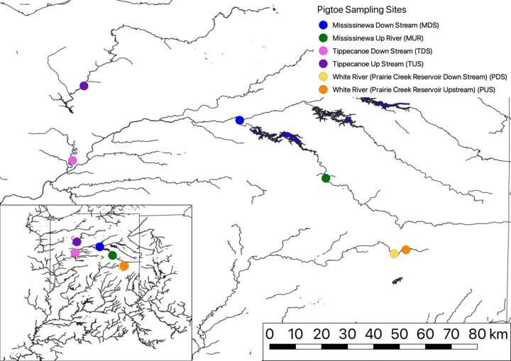
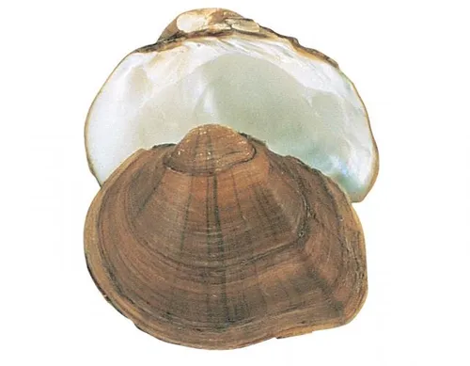
Sample Sites and Target Organism
Notes:
Primarily in Upper Wabash River Basin

Slide 5
Research Question
Overall question is to determine what a healthy individual mussel looks like
However, very little research done on what showcases a healthy mussel
More immediate question is to determine if fatty acids and stable isotopes showcase a difference between populations (hopefully these differences can prove what a healthy mussel looks like)
Notes:
The overarching goal of my research is to determine what exactly a healthy individual mussel looks like. As I said before however, there is a significant knowledge gap when it comes to freshwater mussel research. This is why, at the moment, I am only looking to see if a difference in the populations can be detected using their fatty acid and stable isotope profiles. The basic premise of fatty acid analysis is that signatures of fatty acids can help infer if the environment of a consumer is particularly productive, with polyunsaturated acids in particular being useful as they can’t be made by an organism, only picked up from the environment. The use of stable isotopes is somewhat similar in that the relative concentration of a certain isotope can be used to determine what resources are being used by an organism. It is the hope that by using fatty acid and stable isotope signatures to determine a mussel's sources for diet and resources, we can gleam what sources can influence the health of the mussel.

Slide 6
Data Preprocessing
Merge fatty acid and stable isotope data (done by two different labs)
Remove any entries that have entries with NA or no data (Due to lab analysis)
Reduced from 240 samples to 227
Separate into 4 different relational tables (Saturated Fatty Acids, Monounsaturated Fatty Acids, Polyunsaturated Fatty Acids, and Isotopes)
Notes:
My data was produced by outside labs, with one lab analyzing muscle tissue for fatty acids and the other analyzing for stable isotope profiles. Upon receiving the data from both labs I merged the two datasets together which resulted in a table of 240 rows, with each row representing an individual mussel, and 50 columns with 23 columns consisting of fatty acids and 5 columns that represented the delta values of isotopes which are used to represent their relative concentration. Columns that were not useful in the analysis, such as those provided by the labs for bookkeeping purposes (wet weight of the sample, dry weight, amplitudes of the chromatograph) were removed from the data set. In addition, any rows that contained NAs or were empty due to lab errors or re runs that haven’t been sent were also removed, which resulted in the sample size shrinking to 227.

Slide 7
Methods
Conducted linear discriminant analysis (LDA) to determine how sample sites relate to fatty acids and isotopes
Conducted redundancy analysis (RDA) to determine how fatty acids and isotopes related to each other
Conducted linear mixed models to look at the relationship between the response variable (specific fatty acid or isotope) and the predictor variables (Position related to reservoir and season of sampling)
Notes:
The analytical methods I used to determine the stable isotope and fatty acid differences and relationships between sites were linear discriminant analyses using the MASS package, which was used to see how each site relates to fatty acids and isotopes, redundancy analyses, using the vegan package, which was used to see how fatty acids and isotopes relate to each other, and a linear mixed model, using the package lmerTest, which was used to look at the significance of the relationships of fatty acids or isotopes between the position of the site and the season of when sampling occurred. These results were plotted using ggplot along with various other aesthetic packages.

Slide 8
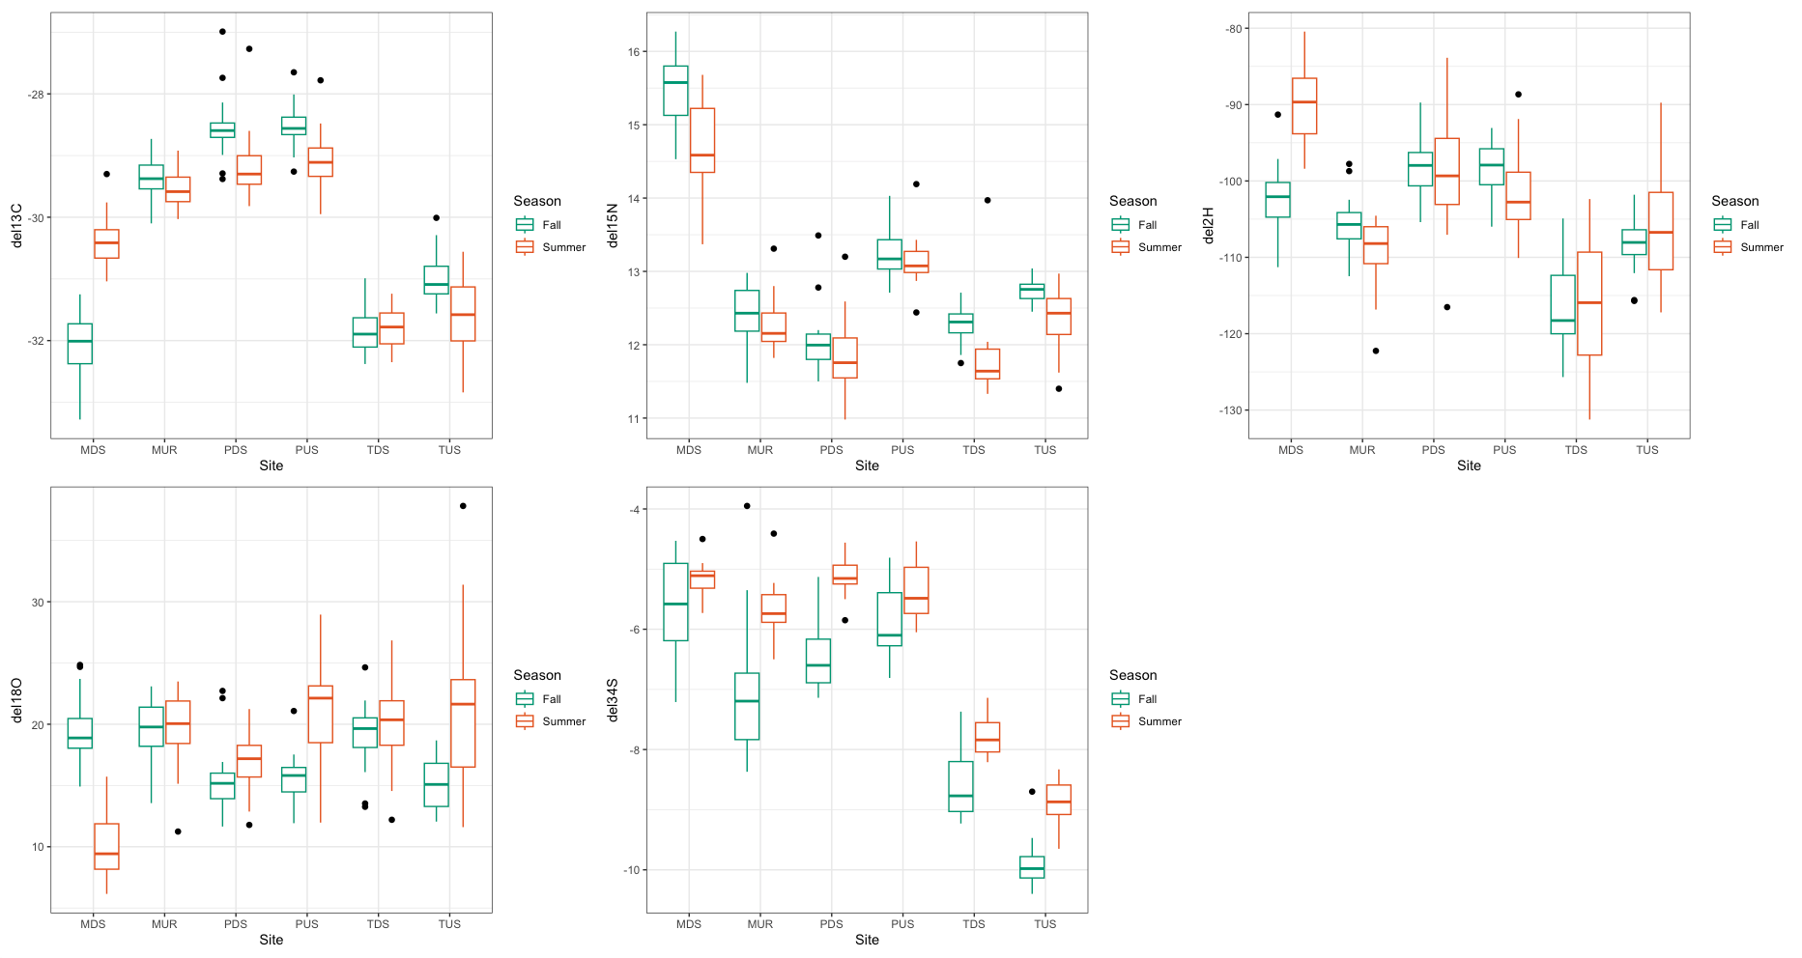
Raw Data Results
Notes:
When first looking at my data I constructed boxplots to simply look at the distribution of the raw data. Focusing on all 5 stable isotopes, there are clear differences between both site and season sampled.

Slide 9
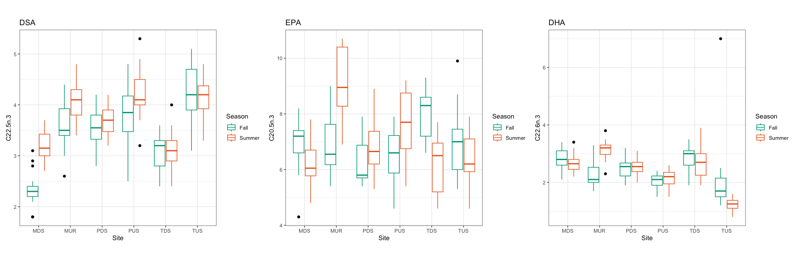
Raw Data Results
Notes:
For fatty acids I decided to limit my boxplots to three fatty acids, which have been shown in previous studies to relate to growth in marine bivalves. In DSA, or docosapentaenoic acid there is some seasonal variation between one or two site. The main source of variation appears to be related to site with DHA or docosahexaenoic acid showing a similar pattern. EPA or eicosapentaenoic acid, shows a high amount of variation between both site and season.
DSA = docosapentaeonic acid
EPA = eicosapentaenoic acid
DHA = docosahexaenoic acid
All have been shown to relate to growth in marine bivalves

Slide 10
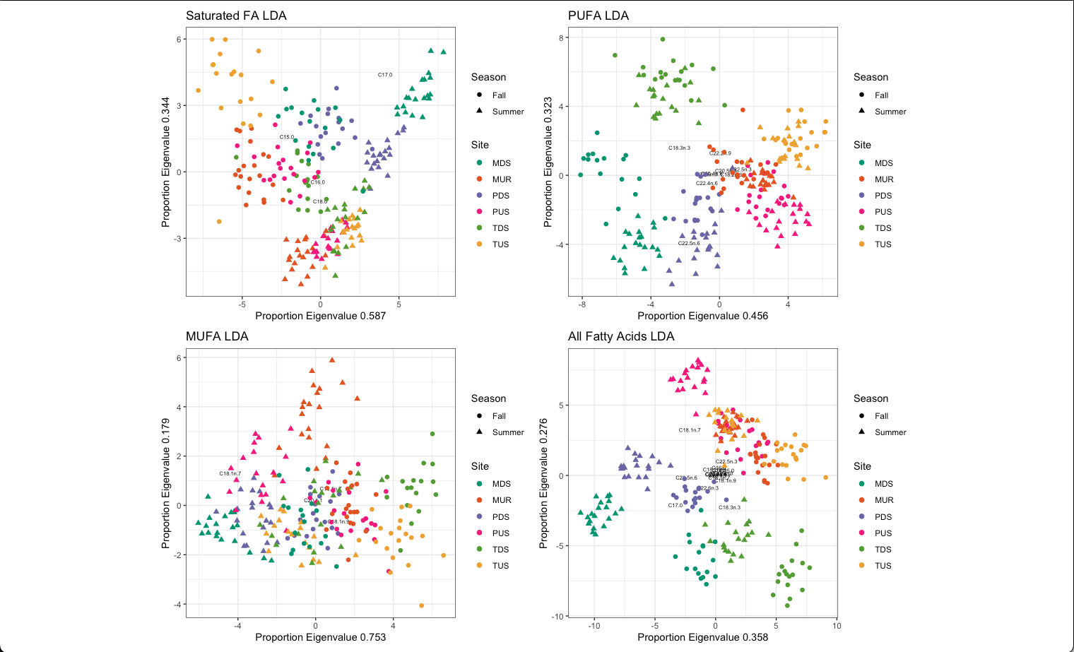
LDA Results
Notes:
As you can see all plots have some degree of separation between both site and season, with the greatest degree of separations being seen in the plots that only measure for polyunsaturated fatty acids or PUFAs and for the plot that measures for all fatty acids. By looking at which fatty acids are closes to which site, you can tell which fatty acids have more of an effect on that particular site. In addition, due to such high levels of separation, going forward we will only be looking at plots for all fatty acids or polyunsaturated acids.

Slide 11
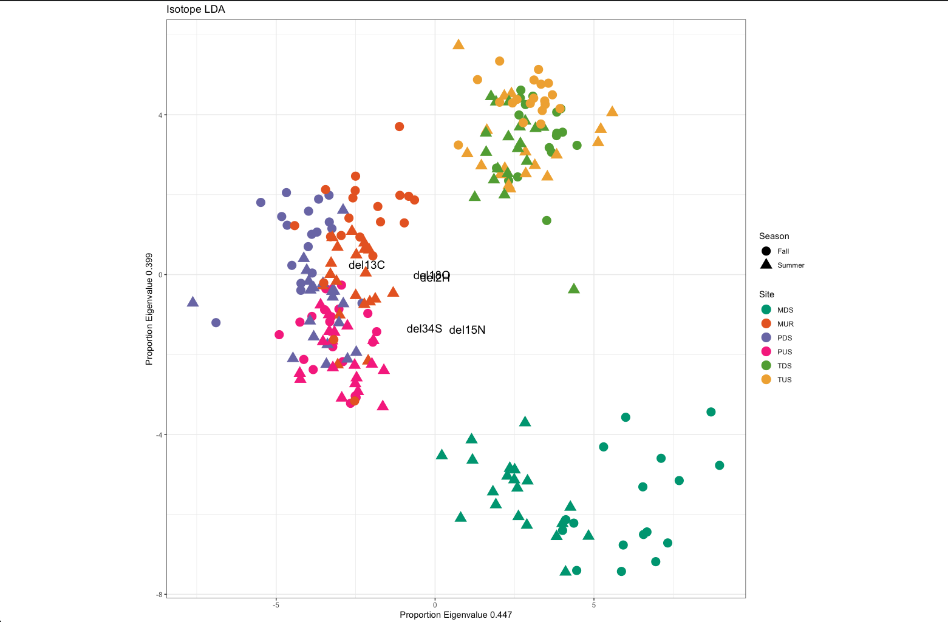
LDA Results
Notes:
Looking at the isotope LDA results, there is some separation but it is not nearly to the extents that are shown in the fatty acid LDAs. For the tippecanoe river and prairie creek site, there is almost no separation while there is an extreme amount of separation for sites along the mississinewa river. One potential reason is that between MDS and MUS there is a dam that is controlled by the army corps of engineers. These dams have specific times when they are open and when they are closed which could explain such a massive separation between the two sites.

Slide 12
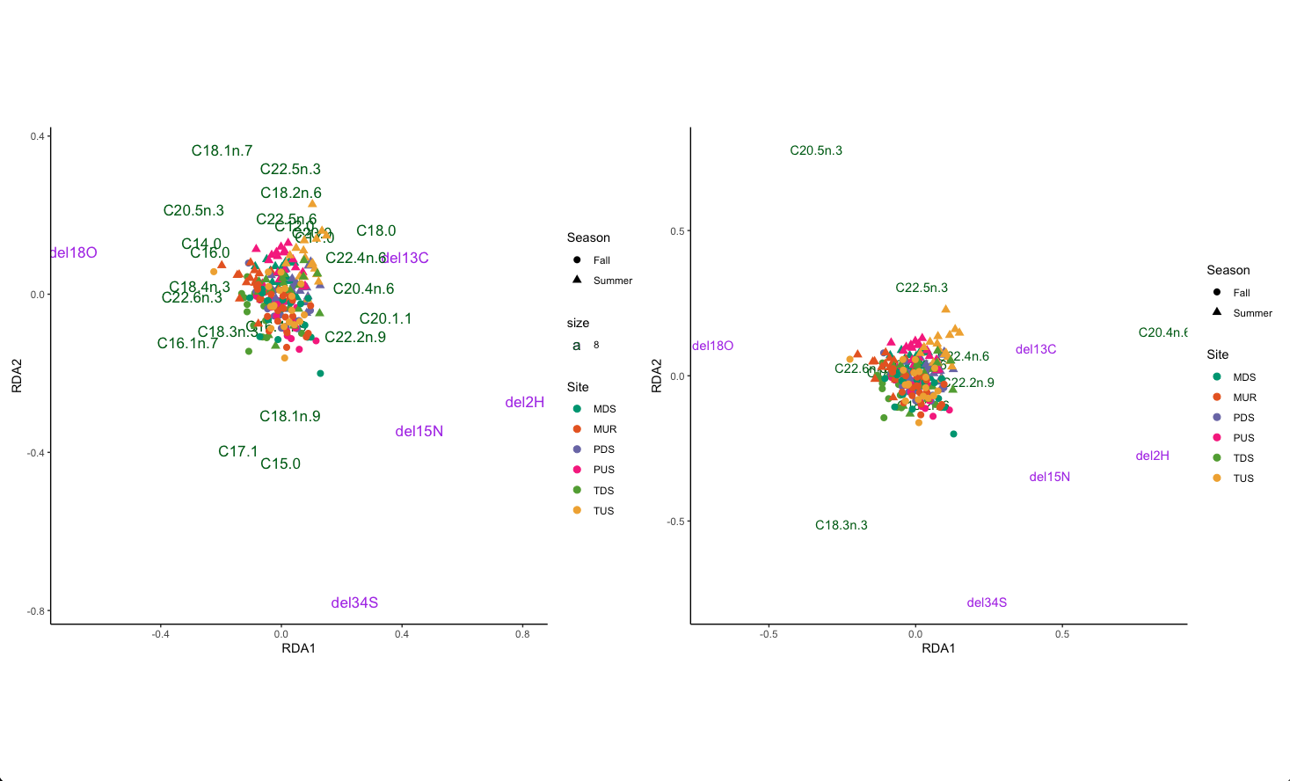
RDA Results
All Fatty Acids
PUFAs
Notes:
As mentioned previously, we can use redundancy analyses to see how fatty acids, which are represented by green lettering, influence stable isotopes, which are represented by purple lettering, and vice versa. For example, in both plots C20.5n.3 consistently stays close to Oxygen 18 which indicates that one should expect to find a high delta value if there is a high amount of C20.5n.3.

Slide 13
Linear Mixed Model Results
Some fatty acids were found to have significant effects from site position and season (DPA) and some did not (EPA and DHA)
Nitrogen and Sulfur were found to have significant effect from season while Carbon, Hydrogen, and Oxygen did not have significant effects
Notes:
The results of my linear mixed models were unfortunately not as useful as my other statistical methods. Having run several fatty acids through the model, only a handful had significant p values when compared to either season or the position of the site where sampling occurred. With stable isotopes, only nitrogen and sulfur had significant p values for season and no significant p values for site position. Carbon, hydrogen, and oxygen did not have any significant p values.

Slide 14
Next Steps
Analyze the microbiome of the mussels through hemolymph DNA extraction
Include more species data to confirm what drives health in mussel
Notes:
In conclusion, it is clear that the stable isotope and fatty acid profiles of mussels appear to be affected by both their location as well as by seasons. Going forward, I will be introducing more species of mussels into the study as well as a larger number of sampling site. Increasing the number of samples should hopefully increase the chances of a significant effect being picked up by my linear mixed models. In addition, to better understand how fatty acids and stable isotopes affect the health of a mussel, I plan on analyzing the hemolymph (or blood) of the mussel for its mircrobiome, which means an in depth look at the different kinds of microorganism that call the mussel home.

Slide 15
Sources
Haag, W. R., & Williams, J. D. (2013, April 28). Biodiversity on the Brink: An assessment of conservation strategies for North American freshwater mussels - hydrobiologia. SpringerLink. https://link.springer.com/article/10.1007/s10750-013-1524-7
Modesto, V., Ilarri, M., Souza, A. T., Lopes-Lima, M., Douda, K., Clavery, M., & Sousa, R. (2017, October 31). Fish and mussels: Importance of fish for Freshwater Mussel Conservation. Wiley Online Library. https://onlinelibrary.wiley.com/doi/full/10.1111/faf.12252

